Slide 1
Vulcan Activity Tracker
CMSC-4920-Senior Project 2
Group2
Team: Margo Bonal, John Gerega, Luke Ruffing

Slide 2
Project Description
The Vulcan Activity Tracker is an athletic app that allows for the logging/tracking of all campus athletics activities. In one combined platform, the Vulcan Activity Tracker aspires to meet student organization needs, social interaction, and exercise goal planning in a free accessible way.

Slide 3
Progress
Challenges
Goal 1- Welcome Page
Goal 2- Creation of docker container and MSSQL database
Goal 3- User login portal/ create account
- 2 step hashing algorithm : SHA-256 & Argon2
- Prevents rainbow, parallel, and other attacks
Team device chip configuration not considered when choosing a database driver
The MSSQL 2022 server version 17 not compatible with ARM 64 chips, Intel Specific.
VM to extensive to implement
Solution: MSSQL-Azure Edge v18

Slide 4
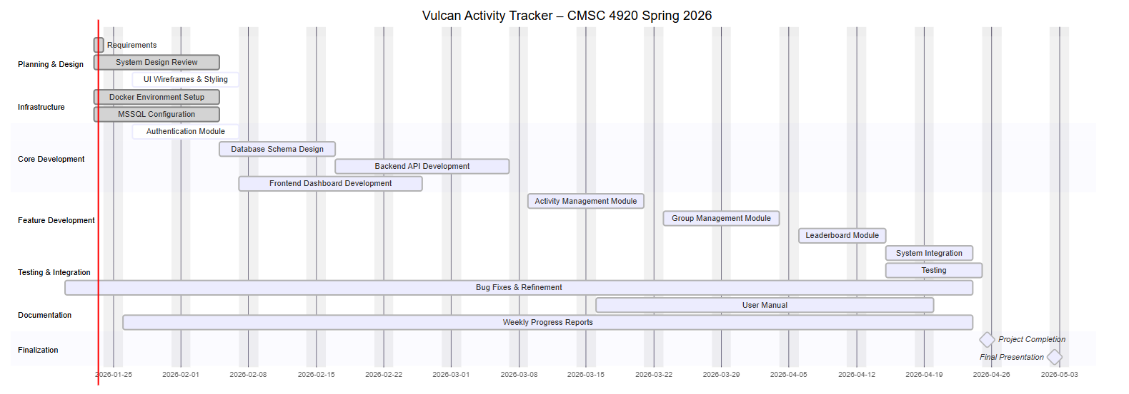
Planning
Gant chart

Slide 5
Website: https://jjdeuce06.github.io/VulcanActivityTracker/

